Slide 1

Basic Details of the Team and Problem Statement
PSID: GLAPS26
Problem Statement Title: Enhancing student experience and career outcomes in universities by overcoming placement, internship, alumni engagement, and event organization challenges.
Team Name: ALPHA CODERS
Team Leader Name: Atharv Bharadwaj
Institute Code (AISHE): U-0513
Institute Name: GLA University , Mathura

Slide 2
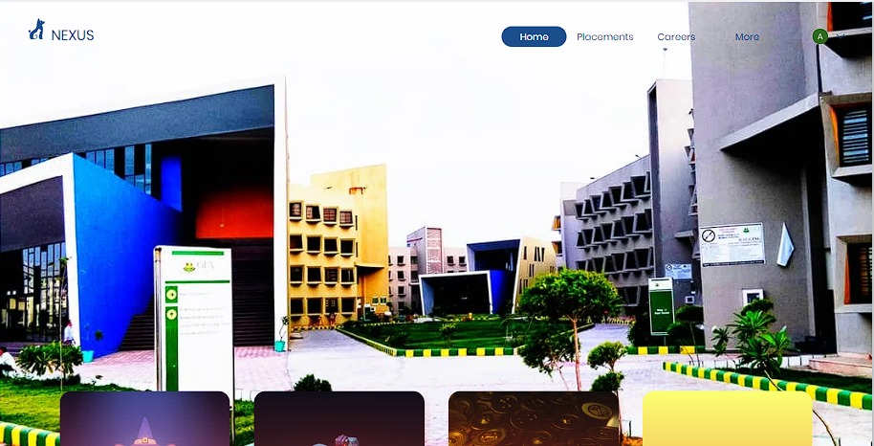
Idea/Approach Details
Describe your idea/Solution/Prototype here:
Introducing a web-based platform that connects alumni and students with other students who have similar interests, enabling them to collaborate on projects and contribute their skills towards achieving common goals.
Provide Placement related information of companies visiting in Campus and eligibility criteria along with Resume samples to help Students.
Fresher’s will get to know about Clubs & Societies with their functionalities.
Students can get Information of Upcoming/Ongoing Events in the Campus along with information related to ticket prices and venue as well as Students will get to know about the purpose of events.
Easily accessible Internship related drives.
Students can access Notes, PYQ‘s, Projects related Drives.
An Alumni network designed to support students in their Academics as well as in their Internships and Placements.
Query solving and information gathering using Chatbot.
GLA UNIVERSITY
PLACEMENT
EVENTS
INTERNSHIP
MORE
Describe your Technology stack here:
HTML,CSS,JS:- Web interfaces
Bootstrap:- For creating responsive web pages easily and quickly.
Firebase:- It is a Cloud-based platform by Google that provides database management ,authentication, hosting.
Chatbot:- It will be trained to solve the issues

Slide 3
Idea/Approach Details
Describe your Use Cases here
Describe your Dependencies
Use Case 1 : Students can find and connect with others who have similar interests, enabling them to collaborate on projects and contribute their skills towards achieving common goals.
Use Case 2 : Students can take overview of placement opportunities within the university so that they can adequately prepare themselves.
Use Case 3 : Students remain up-to-date with the latest internship notifications so that they can grab the opportunity as soon as possible.
Use Case 4: Anyone in the campus can get the details of Clubs, Events ,Placements going on in the University.
Use Cases 5 : Easy availability of Study Material such as PYQ’s, Courses , Notes.
Firebase based authentication
Users database
React JS for User Interfaces
Show stopper here
The primary showstopper for this project is the challenge of attracting a critical mass of users to the platform.
Without a sufficient number of users, the platform would not be able to achieve its goal of connecting alumni and students with similar interests and enabling collaboration on projects.
Effective marketing and user acquisition strategies would be crucial to the success of the project.

Slide 4
Team Member Details
Sr. No. | Name of Team Member | Branch (Btech/Mtech/ PhD etc): | Stream (ECE, CSE etc): | Year | Position in team (Team Leader, Front end Developer, Back end Developer, Full Stack, Data base management etc.)
1 | Atharv Bharadwaj | Btech | CSE | 2nd | Team Leader , Full Stack Developer
2 | Abhishek Sharma | Btech | CSE | 2nd | Front end Developer , Bug Solver
3 | Kanishk Patel | Btech | CSE | 2nd | Front end Developer
4 | Arunodaya Pratap Singh | Btech | CSE | 2nd | Back end Developer , Database management
5 | Chitranshi sharma | Btech | CSE | 2nd | Front end Developer
6 | Deepesh Saraswat | Btech | CSE | 2nd | Front end Developer
Team Mentor/s Details
Sr. No. | Name of Mentor | Category (Academic/Industry): | Expertise (AI/ML/Blockchain etc): | Domain Experience (in Years )
1 | Mr. Mohd Amir Khan | Academic | IOT, Python | 9+ Years

